Slide 1
Chapter 1 – Introduction
2022-2023

Slide 2
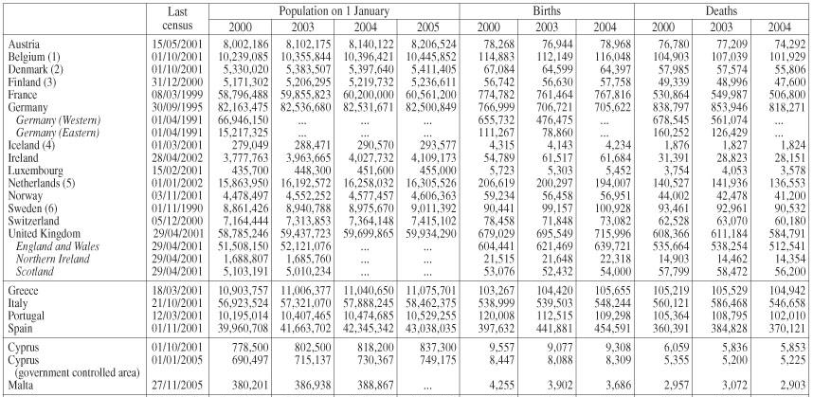
What is data?
Notes:
If you think about Data, you think about Excel sheets. Big tables with a bunch of measurements, numbers, amounts, dates, categories.
Tabular data

Slide 3
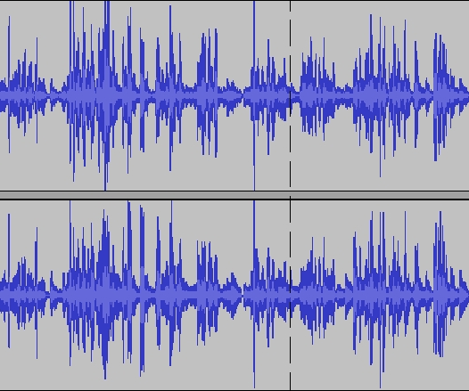
What is data?

Slide 4

What is data?

Slide 5

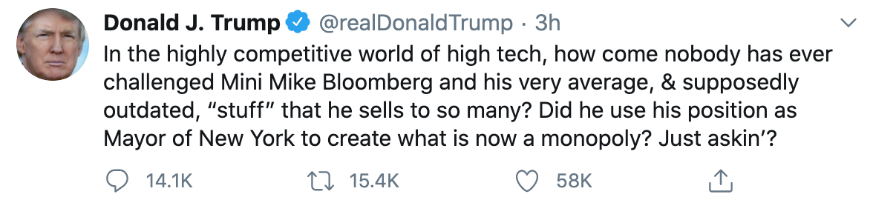
What is data?

Slide 6
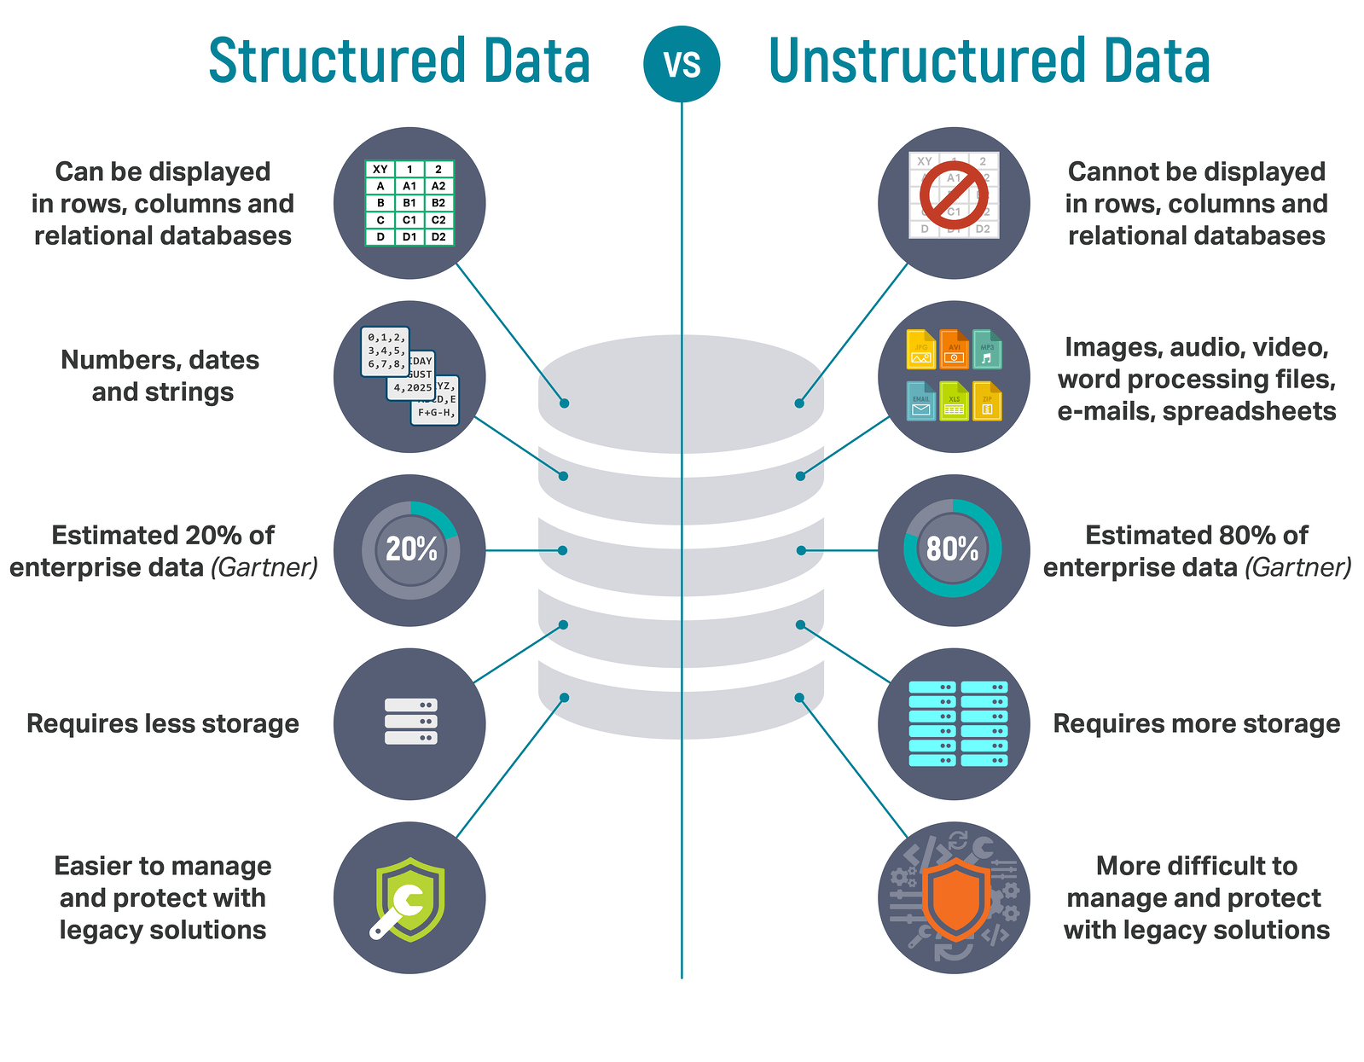


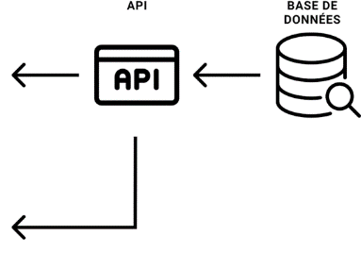
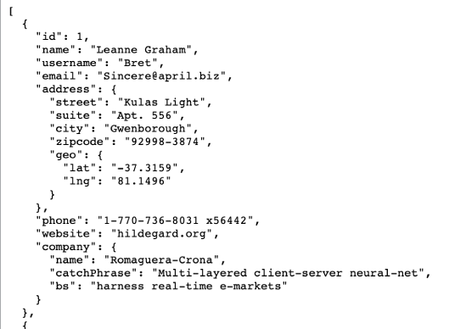
What is data?
Our focus
Big data, Artificial Intelligence

Slide 7
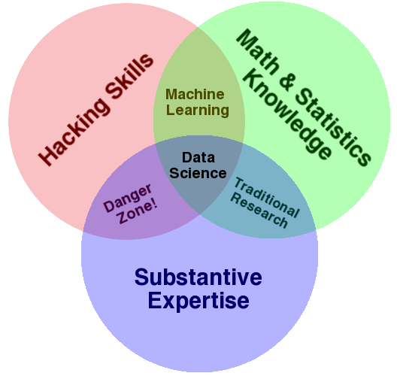
What is data science?
Use scientific methods to uncover information hidden in the data
Focus on structured data
Requires different skills!
Notes:
In this course, we will do data science to analyze structured data, data in tables, but data science can also be used to understand unstructured data like images, audio sounds, and text documents.
To do data science properly, you need three things:
hacking skills, or coding skills, so you can write programs that import and analyze data
math and statistics knowledge, so that you use the correct methods to analyze the data and draw conclusions.
substantive expertise, or basically domain knowledge: you need to know what kind of data you’re dealing with and be able to reason about this data.
Data science is at the intersection of three skills.

Slide 8
Buzzword Bingo
Artificial intelligence (AI): techniques to mimic human intelligence.
Machine learning (ML): subset of AI to have machines learn to do a specific task better with experience.
Deep learning (DL): subset of Machine learning that uses artificial neural networks with many layers.
To do AI/ML/DL well, you need data science to understand your data first.
AI
ML
DL
Data
Science
Notes:
Let’s have a look at how these different buzzwords map to the different classes you’ll have in this semester.
In the Artificial Intelligence class, you’ll get a general intro into AI, recursion, graph search, games, logic program, you’ll do some classical machine learning, and also some deep learning.
In the machine learning class, you’ll use SQL Server Analysis Services, or SASS, to do some traditional ML techniques like linear regression, decision trees, SVMs, etc. It’s more focussed on using the SASS tool.
In the Big Data class, you’ll take a deeper dive into Deep Learning.
In the Data Science class, this one, you’ll use the techniques to understand your data, which is a necessary first step before you can do anything fancy.

Slide 9
Data science or machine learning?
Notes:
This is classical data science. You have data in a tabular format, with rows and columns. By doing some manipulations on this data, you could build an animated visualizations. The result is a compelling plot that shows clearly that as time went on, GDP per capita went up, and life expectancy went up as well. Much better than the boring data we started with in the beginning, and much easier for humans to reason about.

Slide 10
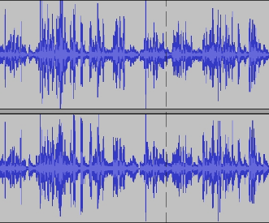
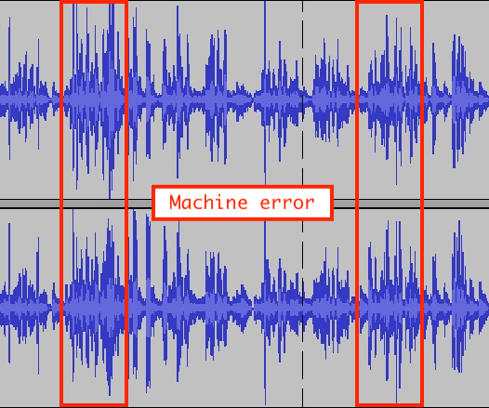
Data science or machine learning?
MODEL
Notes:
This is machine learning. You could use deep learning for this task, but you don’t have to.

Slide 11


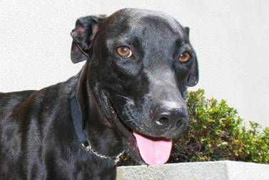



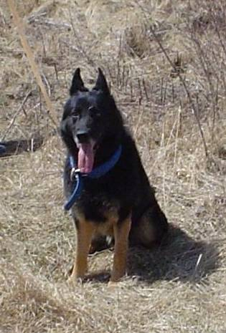





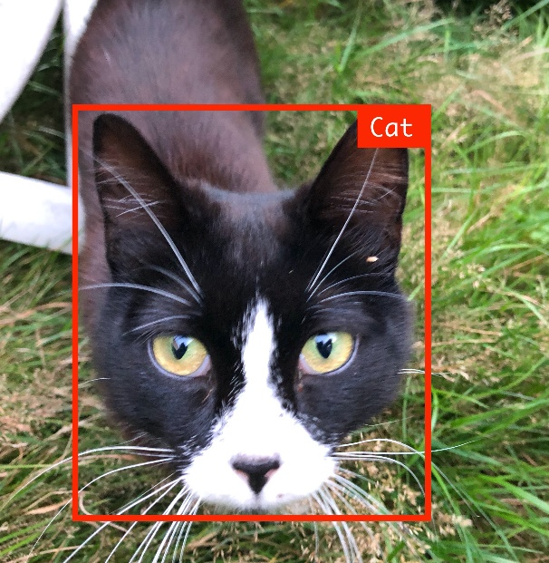
Data science or machine learning?
MODEL
Notes:
This is machine learning. You could use deep learning for this task, but you don’t have to.

Slide 12
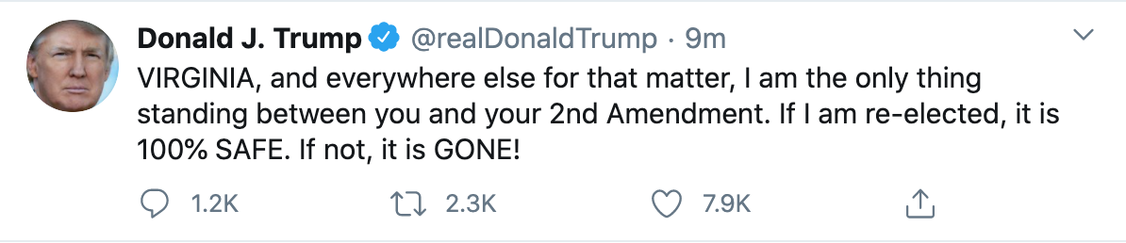
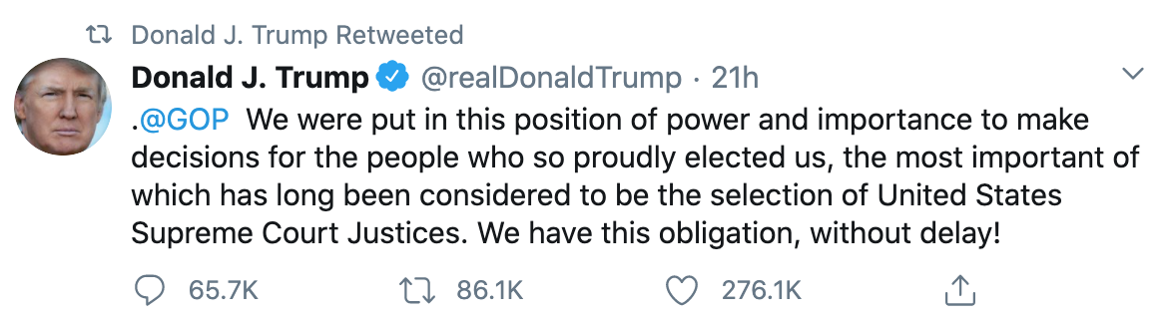


Data science or machine learning?
“Trump’s tweets in 2020 contain on average 270.4 characters.”
“Trump’s tweets in 2020 contain on average 2.4 words that are unnecessarily capitalized”
Notes:
You could analyze a bunch of Trump tweets to see how long his tweets typically are, and whether who often uses capitalized letters when it’s not necessary. This is an example of data science: you’re surfacing insights that are hidden in the data.

Slide 13
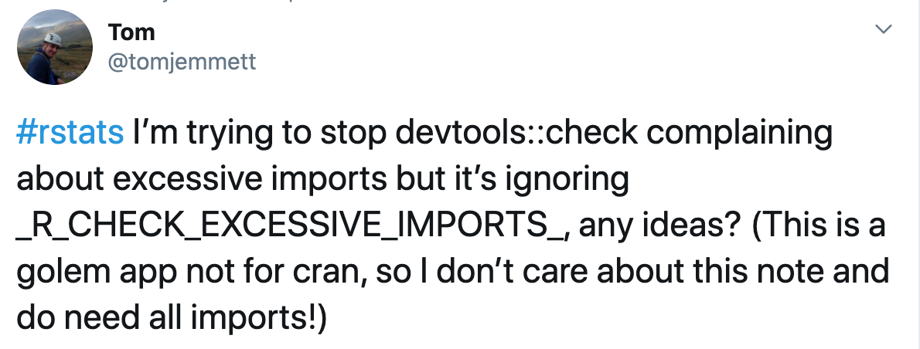
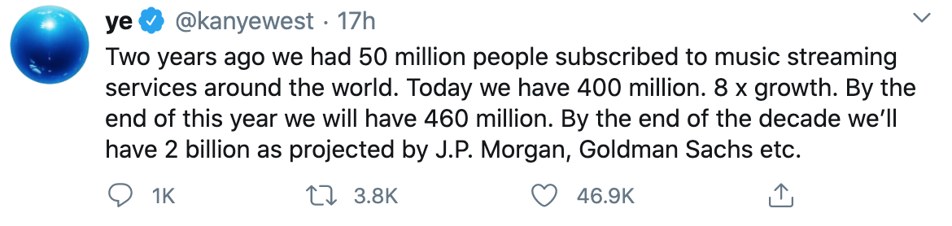
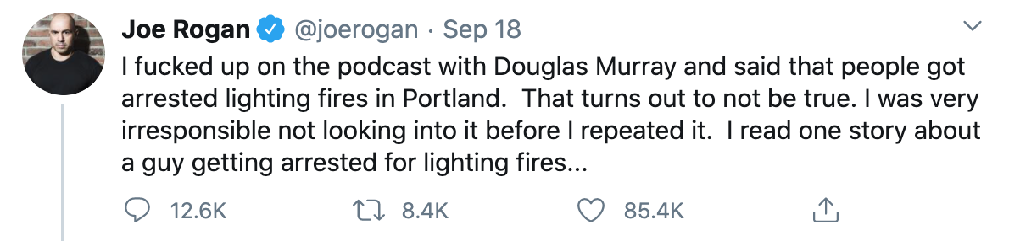

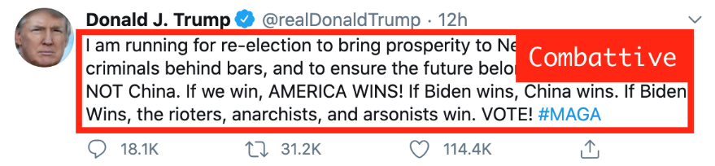
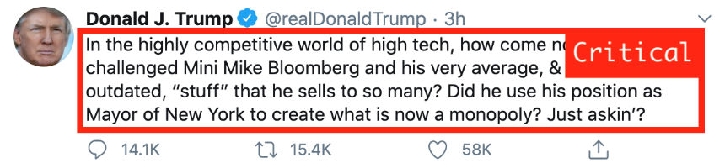
Data science or machine learning?
MODEL
Notes:
You could also do machine learning with these tweets: based on loads of tweets, you could for example build a model that does a sentiment analysis on a tweet, telling whether the tweet was aggressive, friendly, combattive, questioning, etc.
This is classical machine learning, and there are also deep learning approaches for these kinds of tasks.

Slide 14
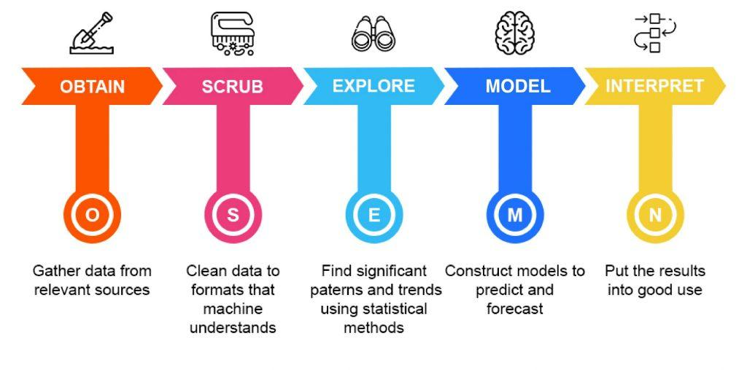
The data science process
Notes:
https://thelead.io/data-science/5-steps-to-a-data-science-project-lifecycle

Slide 15
Step 1: Obtain
Query databases
Read Excel-files
Read API’s
Read CSV’s
…
Get and combine the data from anywhere you can
But: only use properly governed data
more is not better when more means less reliable

Slide 16
Step 2: Scrub
Are all dates recognized as dates?
Are all numbers recognized as numbers?
Combine the information of different files correctly
Does every datapoint translate to a single piece of information?
National Insurance Number: date of birth and gender
Street name and number: Split? Merge?
Are there missing values? How will you deal with them?

Slide 17
Step 3: Explore
Try to make sense of all available data
Create some graphs, examine the distribution of all variables
Is there correlation between the data? Should there be?
High blood pressure in relation to height and weight
Do not assume causation!
If needed, go back to “Scrub”
Identify and label categorical data
Merge or split datapoints
Deal with outliers
Also: talk to the domain experts

Slide 18
Step 4: Model data
Create models that can explain or predict based upon the data you have imported
Classify using logistic regression
Predict using linear regression
Cluster using k-means or hierarchical clustering
We don’t cover this step in this course.

Slide 19
Step 5: Interpret the data
The ultimate goal of every data science-project
Test how the models we made generalize
Explain our findings to a non-domain specialist
Answer the questions we posed in the beginning
Do heavier cars always consume more gas?
In which season are there more insect-bites?
Tell a story using the data you were given.

Slide 20
Summing up
OSEMN | Description | Technologies used
Obtain | Gathering data from databases, the web, open data platforms like Kaggle, … | SQL, Web APIs, Web Scraping via Python libraries like Beautiful Soup, …
Scrub | Organising and tidying up the data, removing what is no longer needed, replacing what is missing and standardising the format across all the data collected. | Python Pandas library
Explore | Inspecting and analyzing the data with descriptive statistics (min-max-mean-median-correlations-distributions-…) and basic visualizations. | Python libraries like NumPy & Pandas Visualization libraries like MatPlotLib & Seaborn Visualization tools like Qlik, Tableau, PowerBI
Model | Setting up models to forecast future values or classify and group values. | Python libraries like SciKit
Interprete | Presenting the data to an audience. Delivering the results in such a way business questions are answered and actionable insights are provided. | Python libraries like Matplotlib & Seaborn Javascript libraries like d3js Dashboarding tools like Qlik, Tableau, PowerBI
Notes:
Explore is for developers (for you), interprete is for the end user (aka the storytelling).
Explore: intermediate sheets
Interprete: create the dashboards

Slide 21
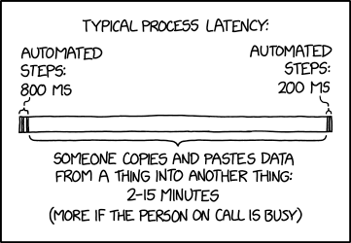
What we want to avoid
Notes:
https://xkcd.com/2565/
We’re going for a full automation of the data-processing pipeline…

Slide 22
Which language?
R
Statistical language, preferred by researchers and mathematicians
Originally the first and only language to do data science in
Python
General purpose programming language, preferred by computer scientists
Evolved into a perfect alternative to R
Julia
Programming language made for data science
Fixes problems that you have with Python when dealing with ginormous amounts of data
Notes:
We chose Python because you have a basic knowledge in that language, which gives us something to build on.

Slide 23
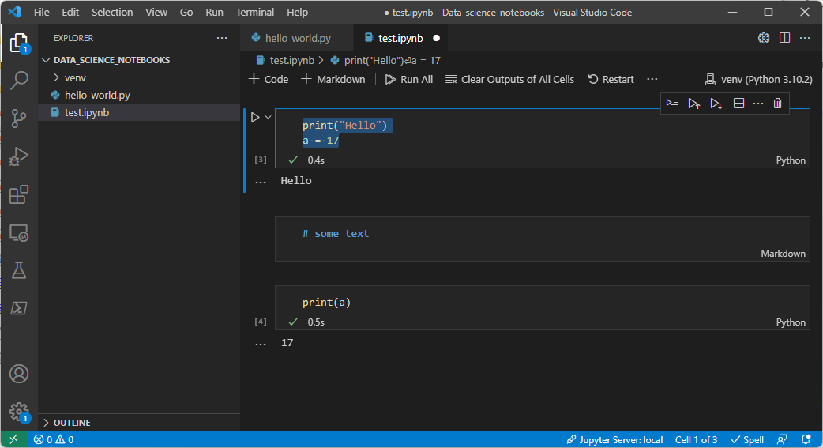
Which IDE?
VSCode and Jupyter notebooks
See markdown-file for installation

Slide 24
And finally
VSCode is a pretty powerful editor:
https://kencenerelli.wordpress.com/2018/03/25/visual-studio-code-multi-line-and-multi-cursor-editing/
Get familiar with it, you’ll use it a lot in the near future!

